Slide 1


Explainable Security for Relational Databases
به نام خدا
Sajad Asadi
Seyed Mohammad Mehdi Ahmadpanah
Computer Eng. And IT Department
Amirkabir University of Technology
May 29, 2016

Slide 2
Reference
Bender, Gabriel, Lucja Kot, and Johannes Gehrke. "Explainable security for relational databases." Proceedings of the 2014 ACM SIGMOD international conference on Management of data. ACM, 2014.

Slide 3
Outline
Introduction
Goal
Database and Security Views
Disclosure Control System
Policy Function
Disclosure Orders
Disclosure Lattice
Policy Formulas
Explanations
Disclosure Control In Practice

Slide 4
Goal
A novel security model
Formal Explanation for security decisions
Query is accepted or denied? Why?

Slide 5
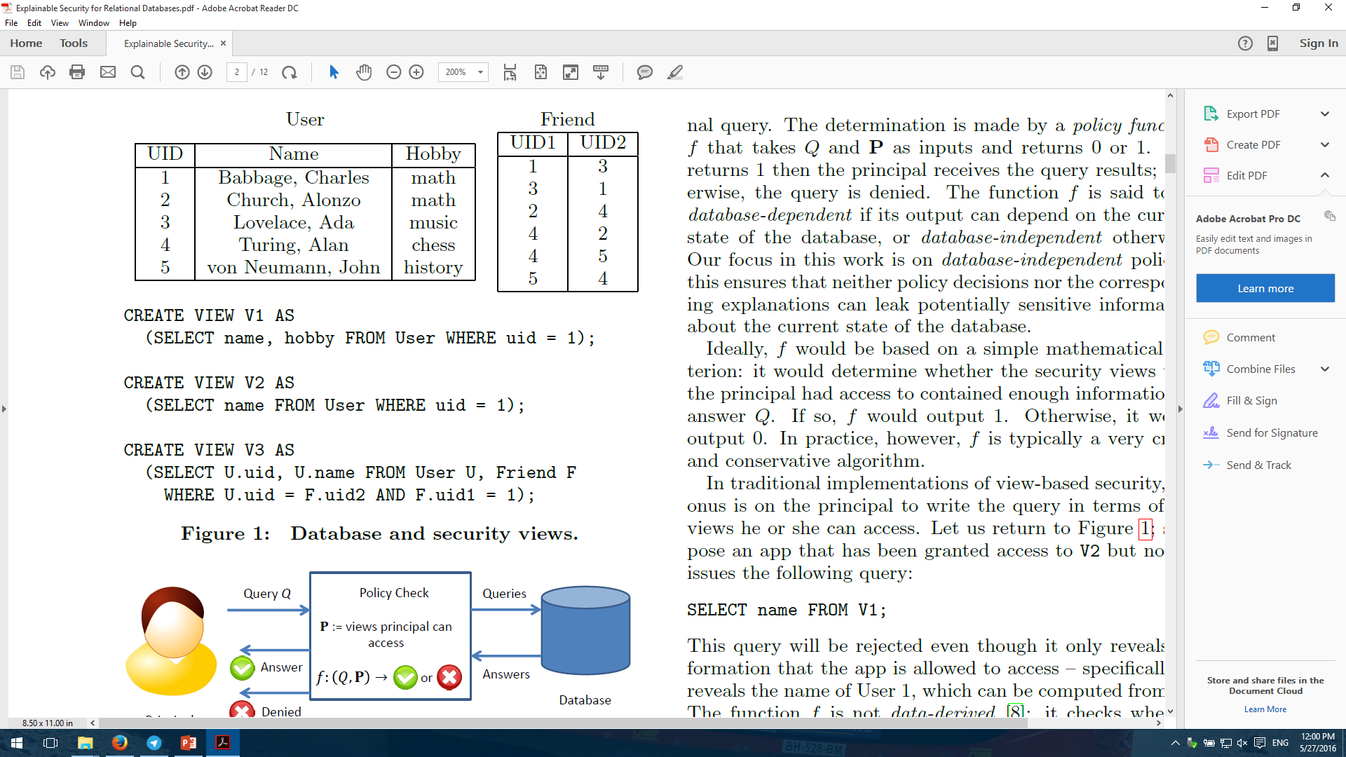
Database & Security Views
Written in Facebook Query Language

Slide 6
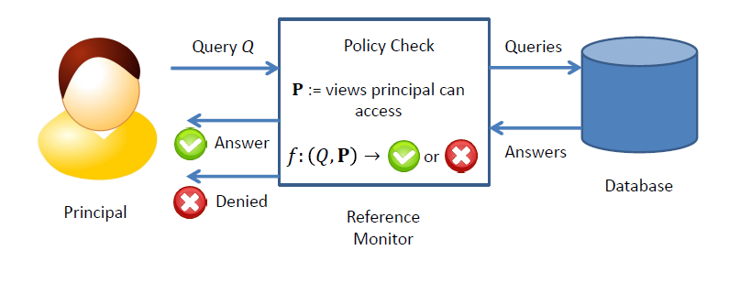
Disclosure Control System

Slide 7
Policy Function
Variety of Policy Function:
Database-independent
Database-dependent
Not-data-derived
Data-derived

Slide 8
Example of not-data-derived
App has been granted to access V2 but not V1:
SELECT name FROM V1;
SELECT name FROM V2;

Slide 9
Two Different Semantics
In both relations and query answers:
Set Semantics : No duplicates
Bag Semantics : Can contain duplicate

Slide 10
Query Language: Conjunctive Query under bag Semantics
H :- B
H (Head of query) is a relational atom.
B (Body of query) is conjunction of relational atoms.
Atom is constant or variable.

Slide 11
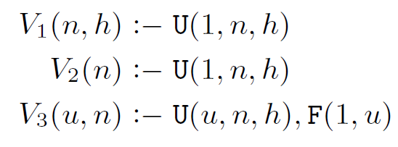
Example

Slide 12
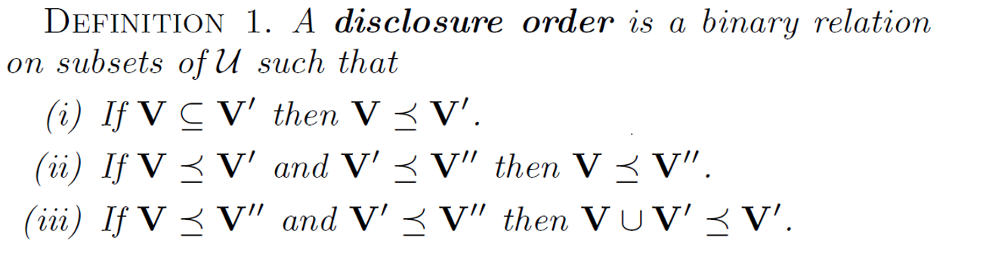
Disclosure Orders
Some set of views (V’) reveal more information about data set than others (V).

Slide 13
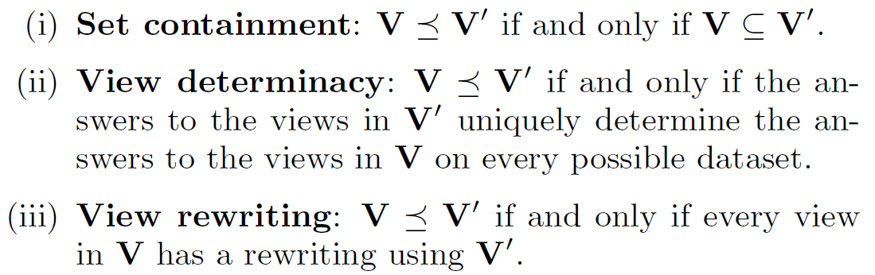
Example

Slide 14
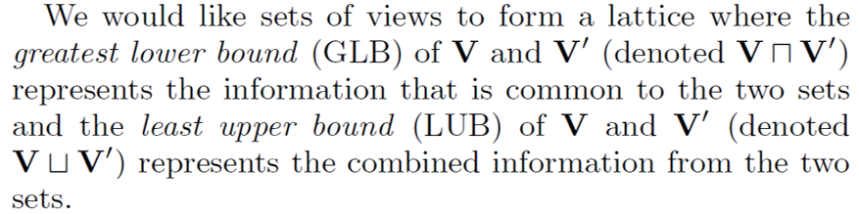
Disclosure Orders to Disclosure Lattice Extension

Slide 15
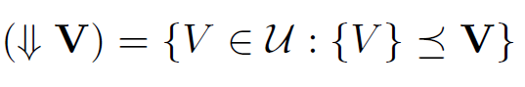
Lattice Property
Reflexivity
Transitivity
Not Antisymmetric!!!

Slide 16
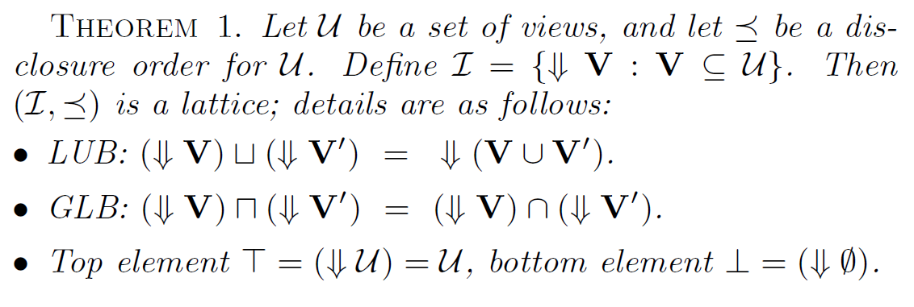
Theorem

Slide 17
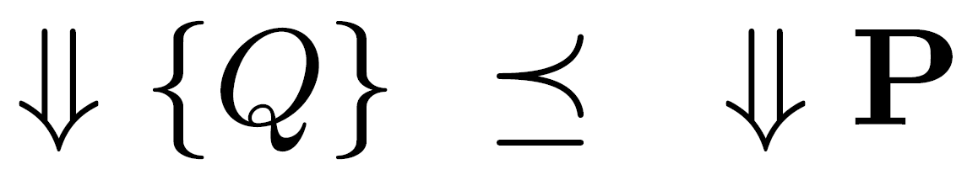
Policy Function
Data-derived policy functions can be expressed in terms of disclosure lattices.
Where P is subset of security views.
f (Q;P) = 1 if and only if {Q} ≤ P

Slide 18
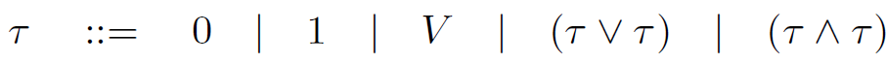
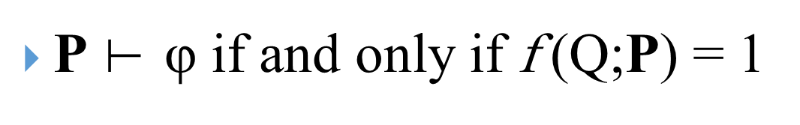
Policy Formulas
Each view in V roughly corresponds to a single permission that a principal may or may not be granted.
Means that φ is provable from P

Slide 19
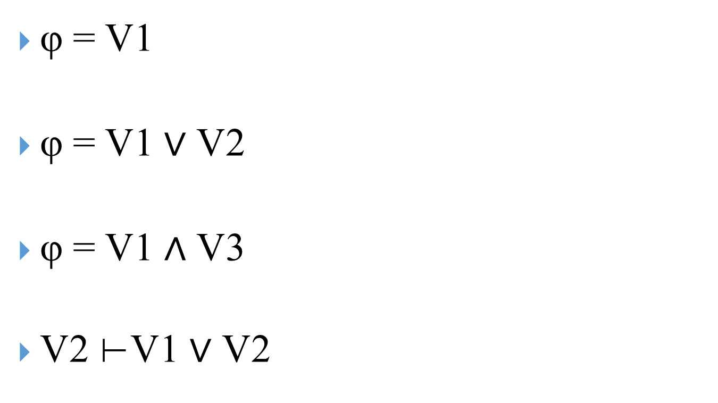
Examples
φ = V1
φ = V1 ∨ V2
φ = V1 $∧$ V3
V2 ⊢V1 ∨ V2

Slide 20
What φ tells?
φ tells us precisely which combinations of the security views contain enough information to uniquely determine the answer to Q.

Slide 21
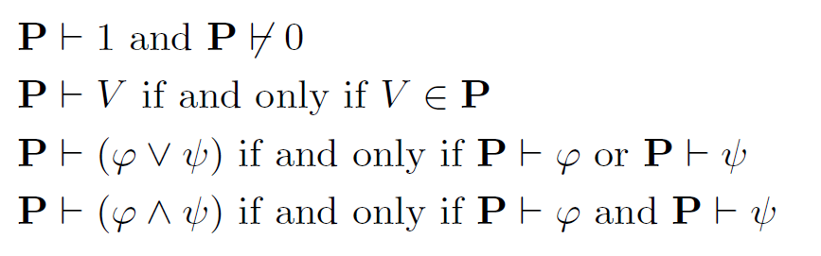
Rules of Reference Monitor

Slide 22
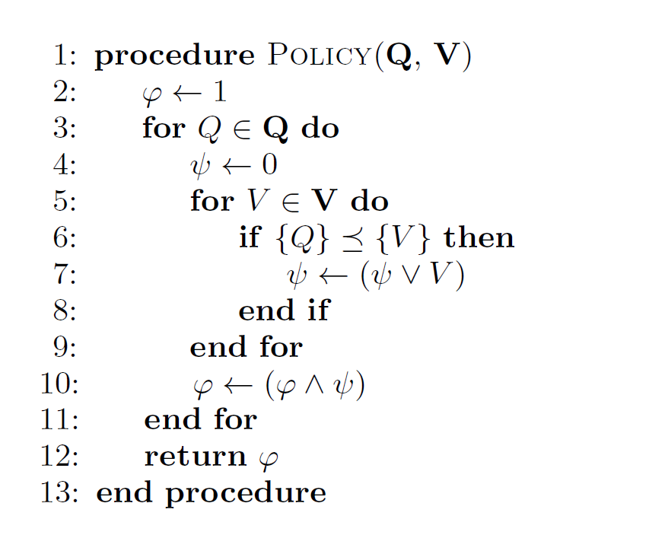
Generating Data-Derived Formulas

Slide 23
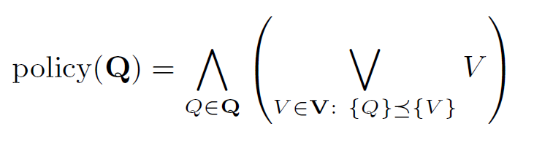
Generating Data-Derived Formulas

Slide 24
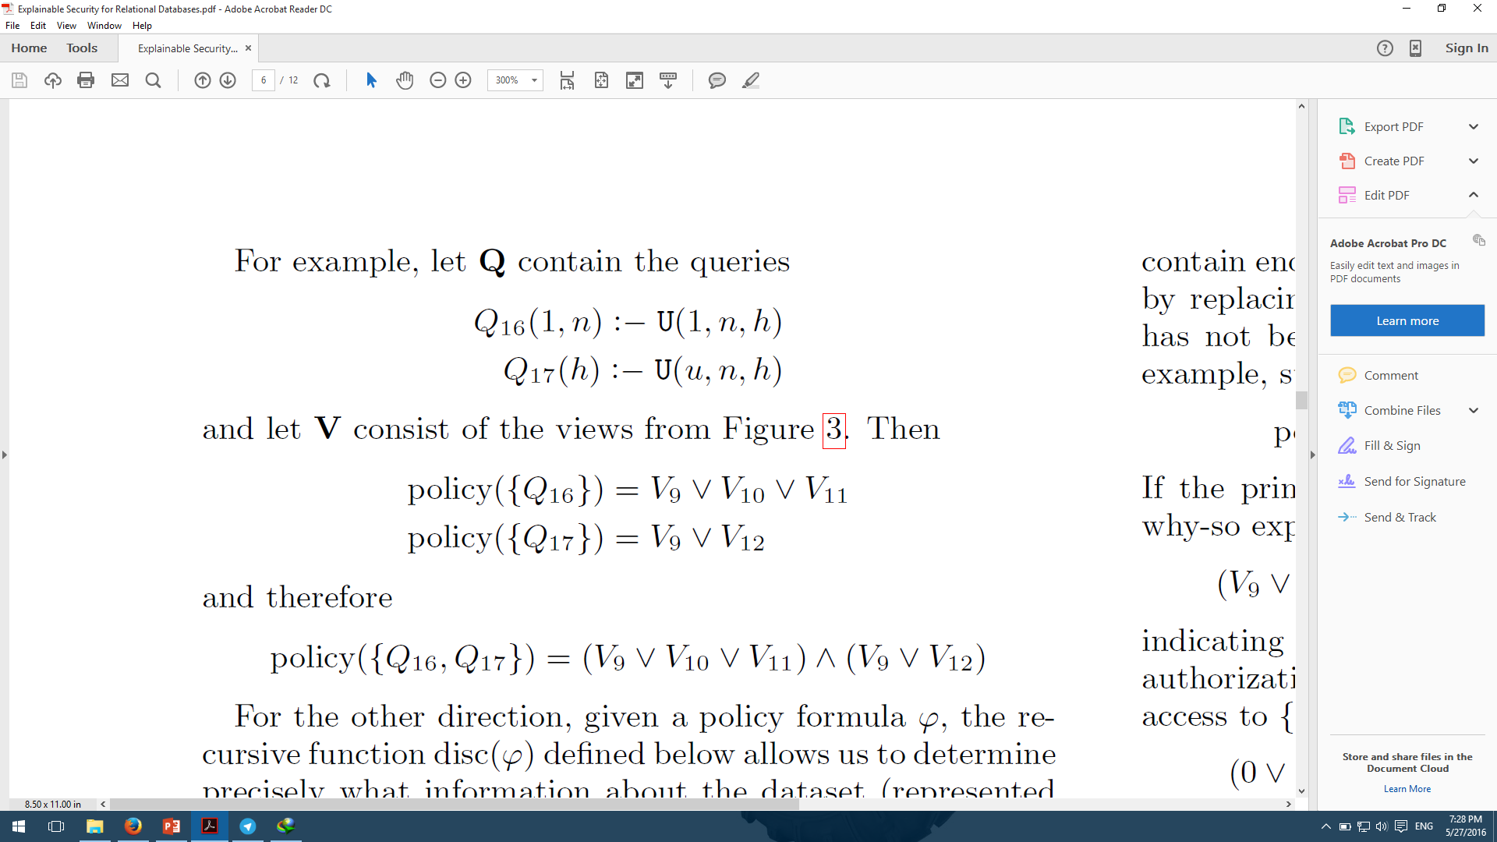
Example

Slide 25
Explanations
Why-so: 0 for every view in policy formula that principal has not been granted access to.
Why-not: 1 for every view in policy formula that principal has been granted access to.

Slide 26
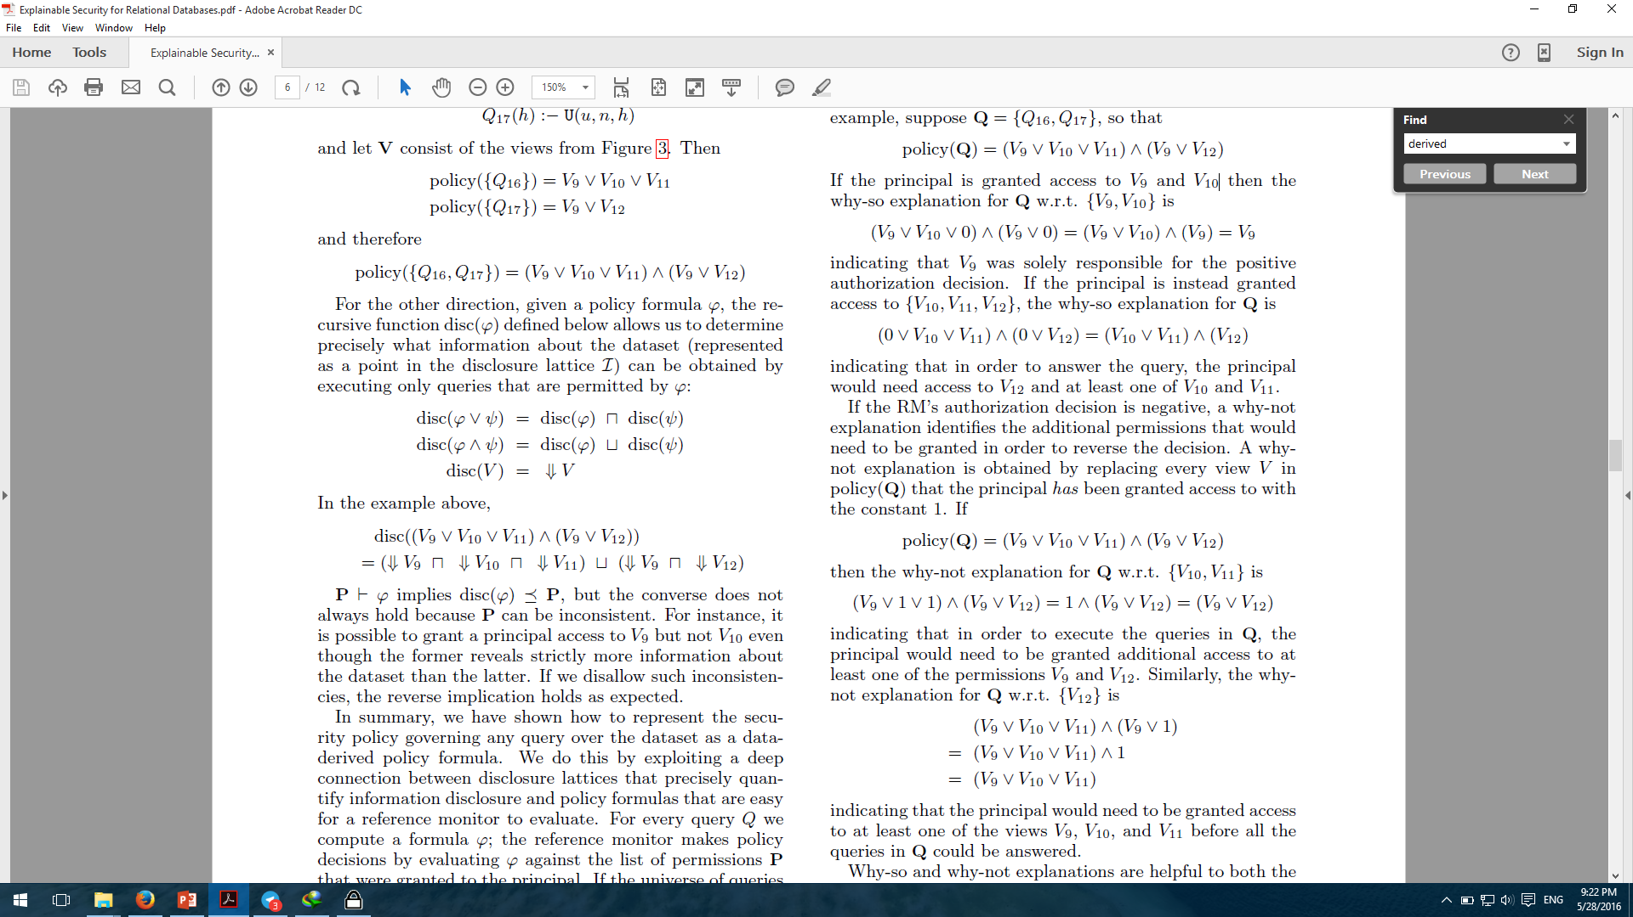
Example
Why-so:
Why-not:

Slide 27
Disclosure Control In Practice
Reflective Policies
policies governing tuples in one part of database can depend on a different part of the same database
Frequently in Practice
e.g. Facebook’s security policies
Notes:
روی تاپل هایی کنترل میکند که ممکن است به بخش دیگری از دیتابیس وابستگی داشته باشند

Slide 28
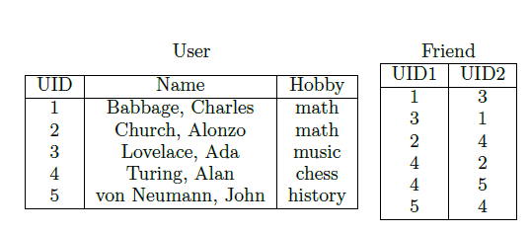
Running Example
SELECT U1.uid, U1.name FROM User U1 WHERE U1.uid IN
(SELECT F1.uid2 FROM Friend F1 WHERE F1.uid1 = 1)

Slide 29
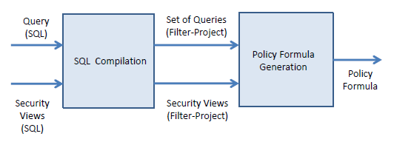
System Architecture

Slide 30
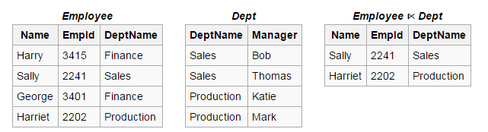
System Architecture (cont.)
Each Security View: Filter-Project Query
SELECT-FROM-WHERE query with semi-joins but not inner or outer joins

Slide 31
System Architecture (cont.)
Compilation is conservative
Policy Formula → Upper bound on the information needed to answer a query
Database-independent
Policy formula and Explanations

Slide 32
Filter-Project Queries
Tables vs. Table Instances
Query-independent vs. FROM clauses
SELECT U1.uid, U1.name FROM User U1, Friend F1
WHERE F1.uid1 = 1 AND F1.uid2 = U1.uid
Which columns and rows in each table instance can affect the query’s output?

Slide 33
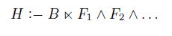
Filter-Project Queries (cont.)
A head atom H
A main body atom B
zero or more filter atoms F₁,F₂,…

Slide 34
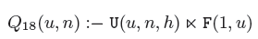
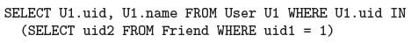
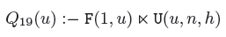
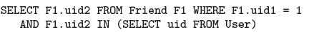
Filter-Project Queries (cont.)
Running Example:
SELECT U1.uid, U1.name FROM User U1, Friend F1
WHERE F1.uid1 = 1 AND F1.uid2 = U1.uid
Filter-project query for U1
Filter-project query for F1
Notes:
that the answers to Q18 and Q19 jointly contain
enough information to uniquely determine the answer to the
original SQL query on any possible dataset.

Slide 35
Filter-Project Queries (cont.)
Filter atoms in the query language correspond to semi-joins in standard SQL
Order filter-project queries according to the amount of information they disclose about their main body atoms
RM will preform exactly one policy check for each table instance in the original SQL query
The universe of filter-project queries is decomposable

Slide 36
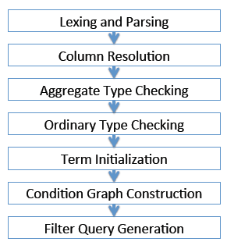
Query Compilation Pipeline

Slide 37
Preprocessing and Column Resolution
Lexing and Parsing using JSqlParser
Execution a series of passes on the Abstract Syntax Tree (ATS)
Identify table instances
Preform column resolution

Slide 38
Type Checking
Aggressive type-checking on the AST
Aggregate type-checking
SELECT SUM(SUM(U1.uid)) FROM User U1
Ordinary type-checking
SELECT * FROM User U1 WHERE U1.uid IN (SELECT F1.uid1, F1.uid2 FROM Friend F1)

Slide 39
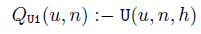
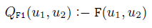
Term Initialization
Convert the AST for a SQL query Q into a collection of projection queries
Together reveal enough information to uniquely determine the answer to Q on any possible dataset
1. Generate one query for each table instance in Q
2. Determine the existential and distinguished variables in query
Notes:
Existential is never referenced in definition of Q
Otherwise Distinguished

Slide 40
Generating Filter-Project Queries
3. Condition Graph
Determine equality constraints and filter atoms to be added to the queries of the previous step
Reachability in the condition graph
Similar to expression trees in the Relational Algebra
Notes:
Our criterion is based on reachability in the condition graph: a directed path from table instance R to table instance S indicates that a tuple in R can only
affect the query's output if it can be joined with a tuple from S.

Slide 41
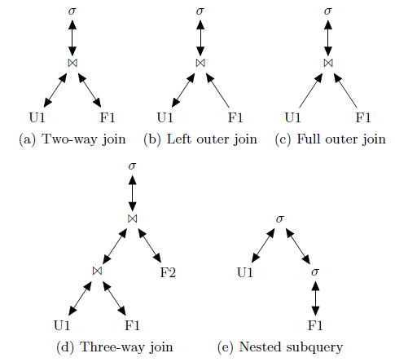
Generating Filter-Project Queries (cont.)
Condition Graph
Notes:
The condition graph for a query Q contains one node (labeled
) for each SELECT statement in the query, one node
(labeled 1) for each two-way join in the query's logical evaluation
plan, and one node for each table instance defined by
the query. Figures 8a through 8e show the condition graphs
for the SQL queries from Figures 7a through 7e respectively

Slide 42
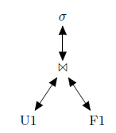
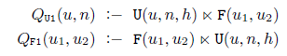
Example

Slide 43
Generating Filter-Project Queries (cont.)
4. Find equality constraints to be added to the previous queries
Finding all SELECCT nodes that are reachable from the condition graph node associated with the table instances
Then check WHERE and HAVING clauses

Slide 44
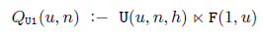
Example
Constraints: (F1.uid1 = 1) and (F1.uid2 = U1.uid)

Slide 45
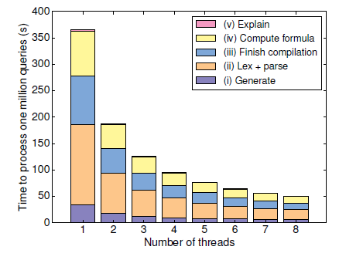
Experimental Evaluation
Performance for ordinary queries
Nearly linearly with the number of cores

Slide 46

Any Questions?

Slide 47


